Slide 1

Apache Kafka
Data pipelining

Slide 2
Agenda
Kafka – Data Pipelining
Flume – Data Ingestion in to Hadoop
Spark Streaming – Near Real Time Micro Batch Analytics

Slide 3
We are not going to cover Installations in this session.. But we will teach you how to program ☺

Slide 4
Kafka
Producers
Consumers
Brokers

Slide 5
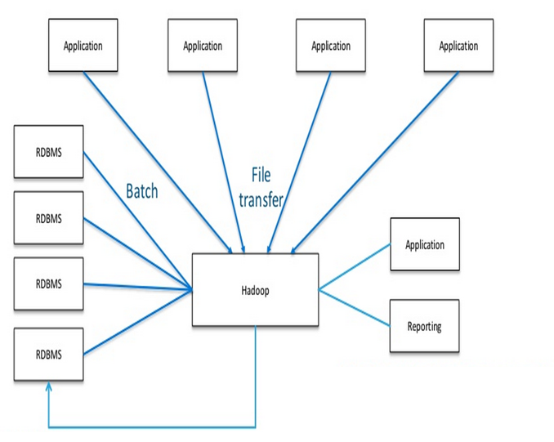
Before Kafka

Slide 6
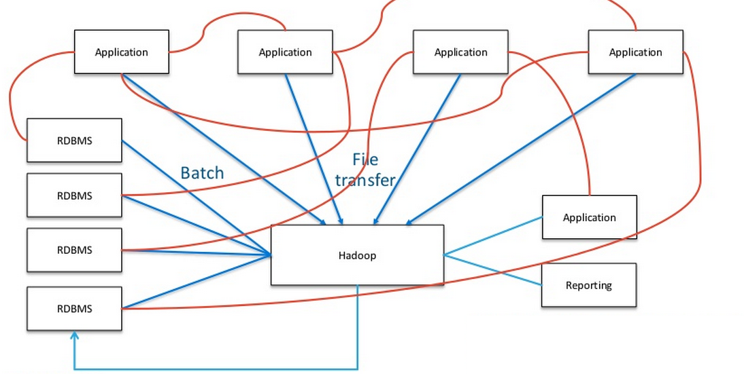
Complicated Ingestions!!
See how complicated the transfers are becoming,
Answer?

Slide 7
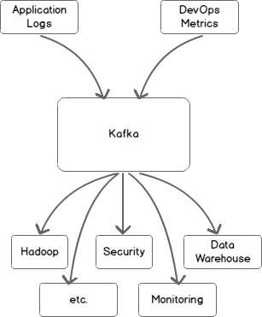
With Kafka
With Kafka, Data pipelining
Becomes easy.
Kafka will hold the data temporarily for you.
Save it and use it!!

Slide 8
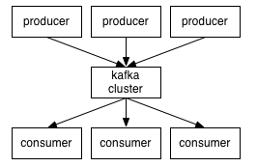
Kafka
Publish – Subscribe model
High Throughput
Low latency, Fault Tolerant
Topics
Producer
Consumer
Broker

Slide 9

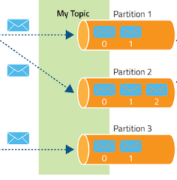
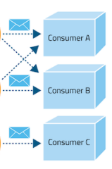
Pub Sub Model
Producers publish data.
Kafka Brokers temporarily stores them
In Kafka Cluster as topics.
Consumers read the data.

Slide 10
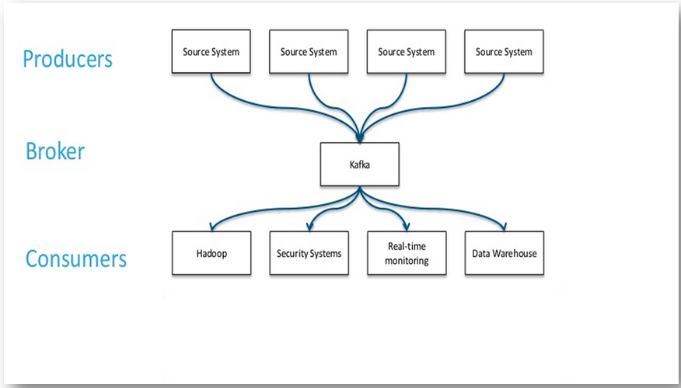

Why Kafka
Beauty in Kafka is, it decouples pipelines.
Producers can push the data to Kafka.
Consumers can now pull data from Kafka.
Assume there is no Kafka, now each
Consumer should connect to producer using
Its API. In the above case, each consumer
Should use 4 producer API’s to collect the data.
With Kafka, each consumer can just use one API ☺

Slide 11
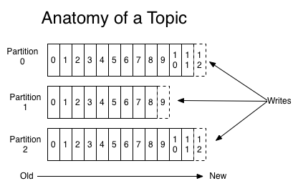
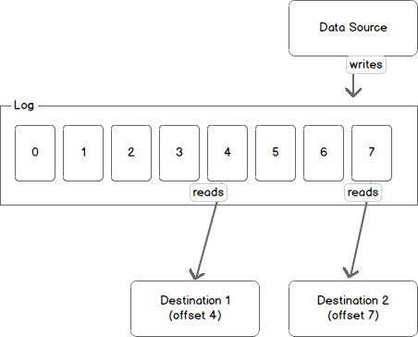
Anatomy of Kafka Topic
Say there are 10 data sources pushing data,
In this case, 10 topics can be created in Kafka
Which will logically separate them.

Slide 12
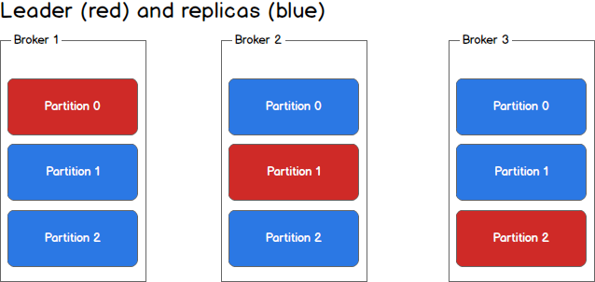
Partitions and Brokers
Brokers hold the data.
Each broker can have multiple partitions.
When data comes in, it will first flow in to Leader.
And leader replicates it.

Slide 13
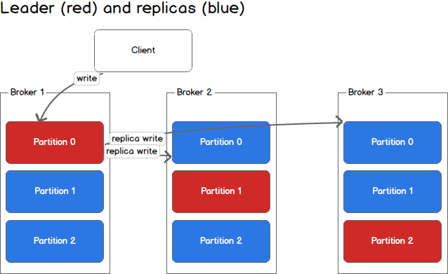
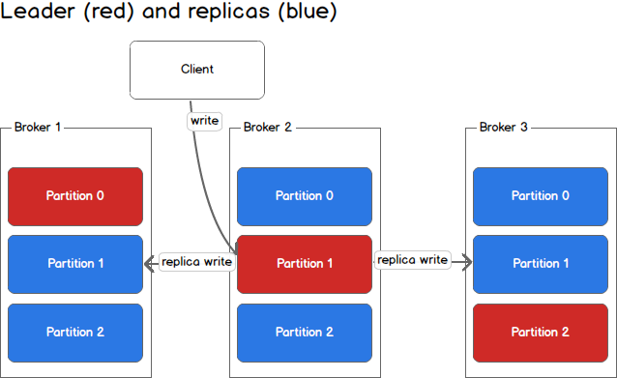
Producers

Slide 14
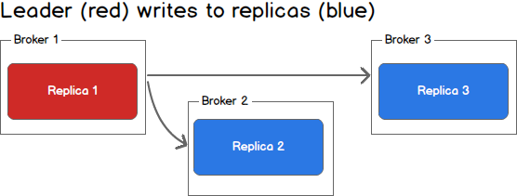
Handling Failures
If a replica fails,
Leader will write only to live replicas.

Slide 15
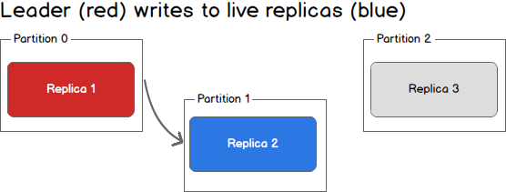
Handling Failures

Slide 16
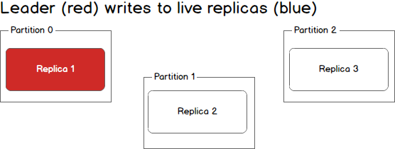
Handling Failures

Slide 17
Kafka Lab

